Slide 1
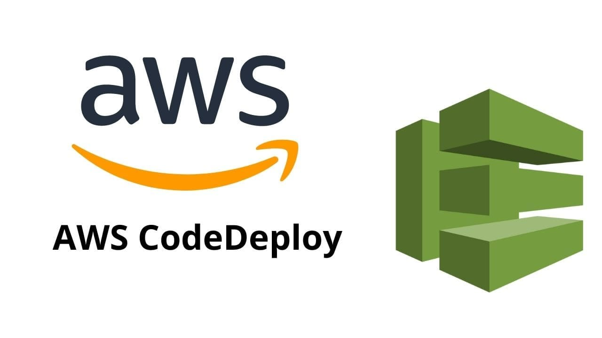

Slide 2
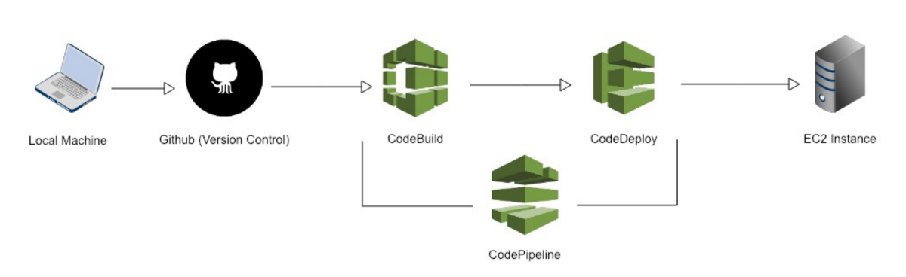
Introduction:
AWS CodeDeploy is a fully managed deployment service that automates software deployments to a variety of compute services such as Amazon EC2 instances, AWS Lambda, and on-premises servers.
It helps developers and DevOps teams to easily deploy applications and updates in a reliable and consistent manner, reducing the risk of errors during deployment and enabling faster application delivery.
CodeDeploy can be used to deploy a wide variety of applications, including web apps, microservices, backend APIs, serverless applications.

Slide 3
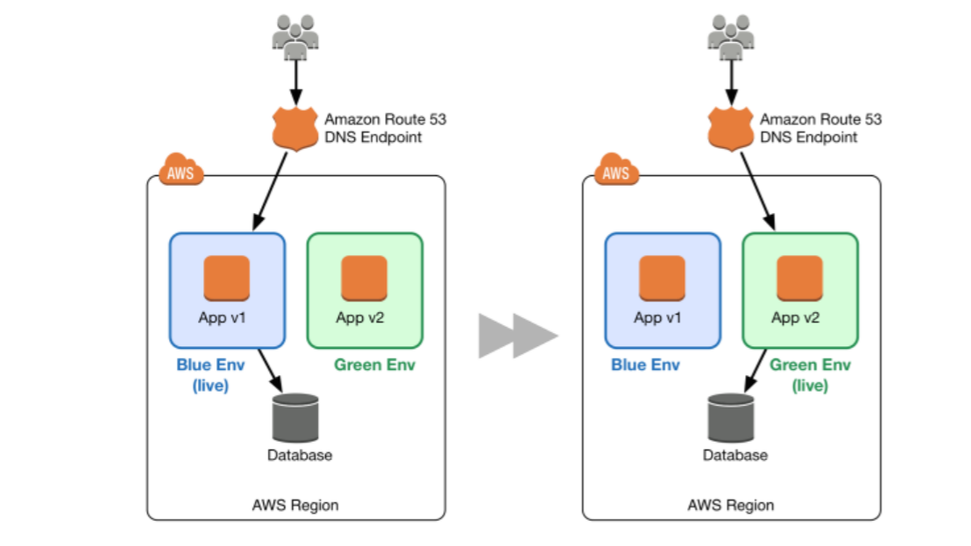
Features of AWS CodeDeploy
Automated Deployments
Deployment Strategies
In-place deployment
Blue/Green deployment
Multi-Environment Deployments
Scalability

Slide 4
Prerequisites for Implementation:
Before starting, ensure you have an AWS account and the necessary permissions to create and manage CodeDeploy resources.
Familiarity with EC2, IAM roles, and S3 buckets is also beneficial for a smoother process.

Slide 5
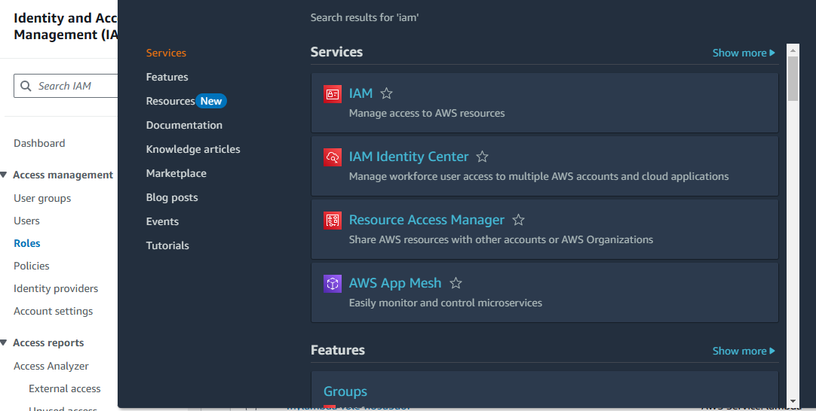
Create IAM Role

Slide 6
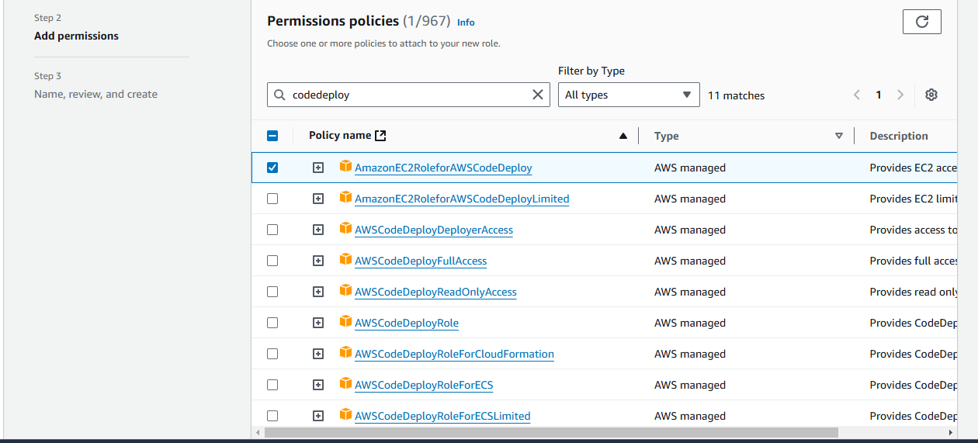
Permission policies : Select amazonEC2RoleforAWSCodeDeploy

Slide 7
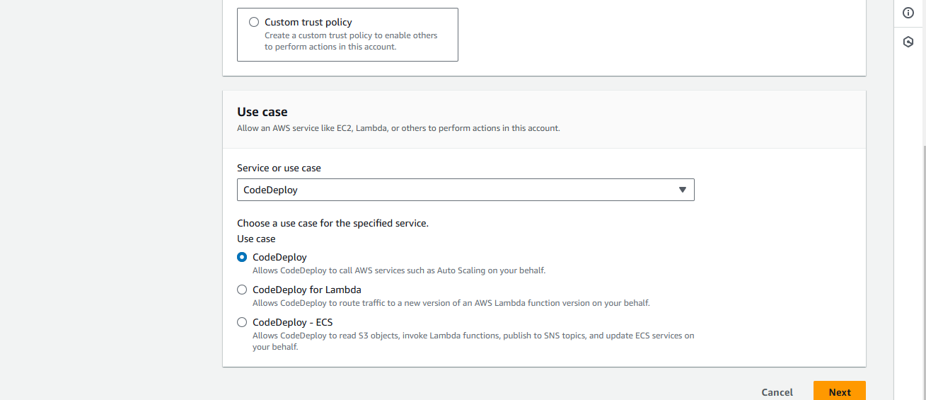
Here select use case as CodeDeploy

Slide 8
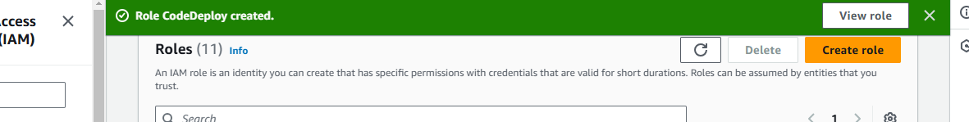
Here two roles successfully created.

Slide 9
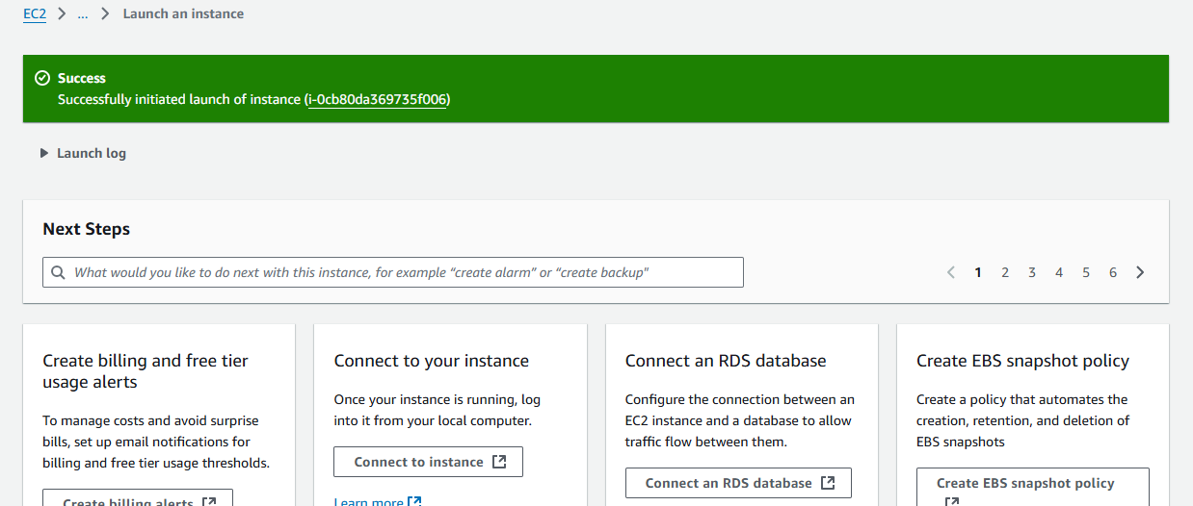
Create EC2 instance using linux server

Slide 10
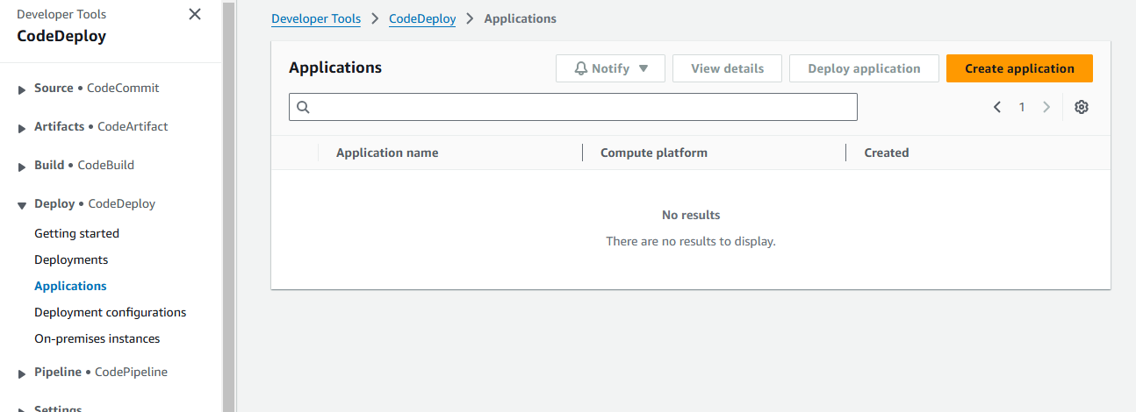
Search CodeDeploy and click on it.

Slide 11
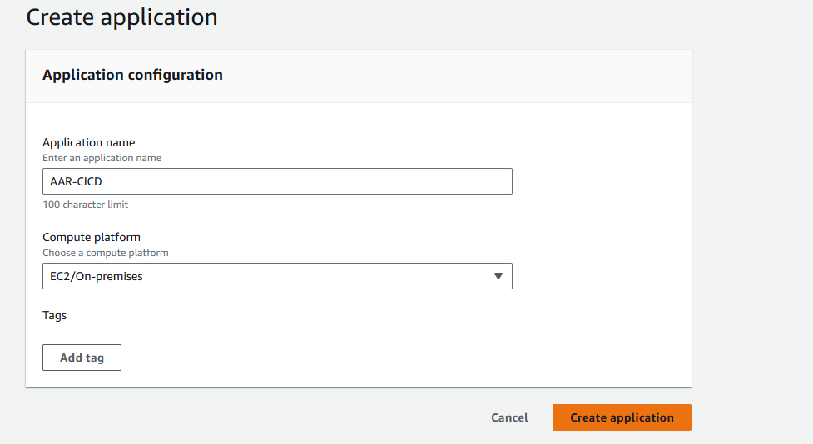
Create application and give a name as AAR-CICD and select EC2 compute platform.

Slide 12
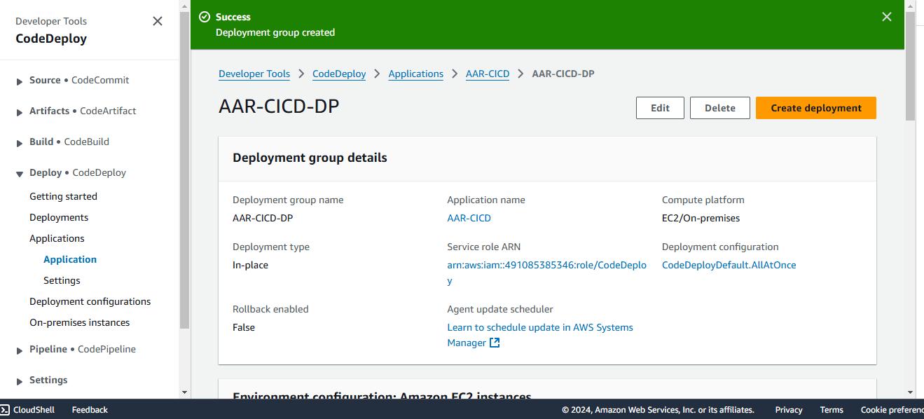
Create Deployment and give name as AAR-CICD-DP

Slide 13
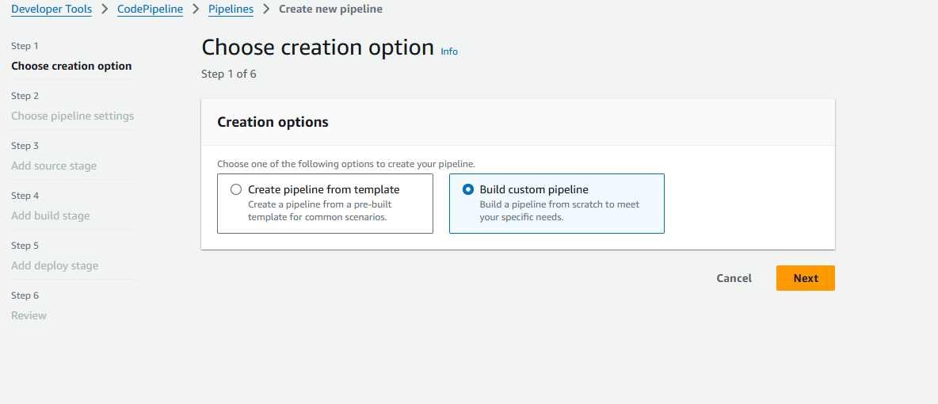
Choose creation option in pipeline and select build custom pipeline

Slide 14
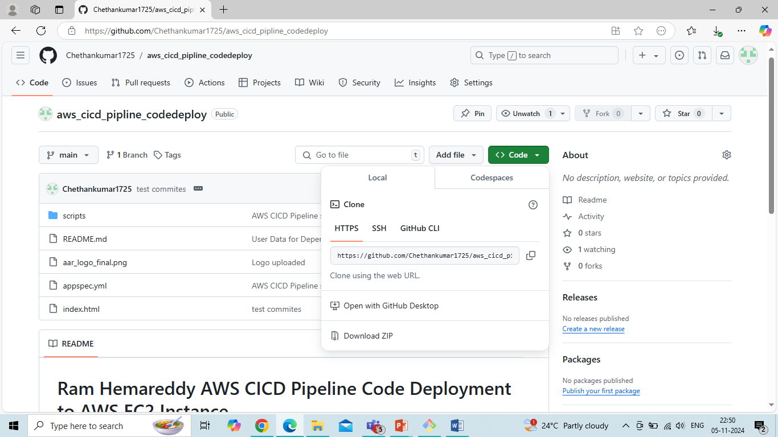
Login to github using credentials and use below repository: https://github.com/Chethankumar1725/aws_cicd_pipline_codedeploy.git

Slide 15
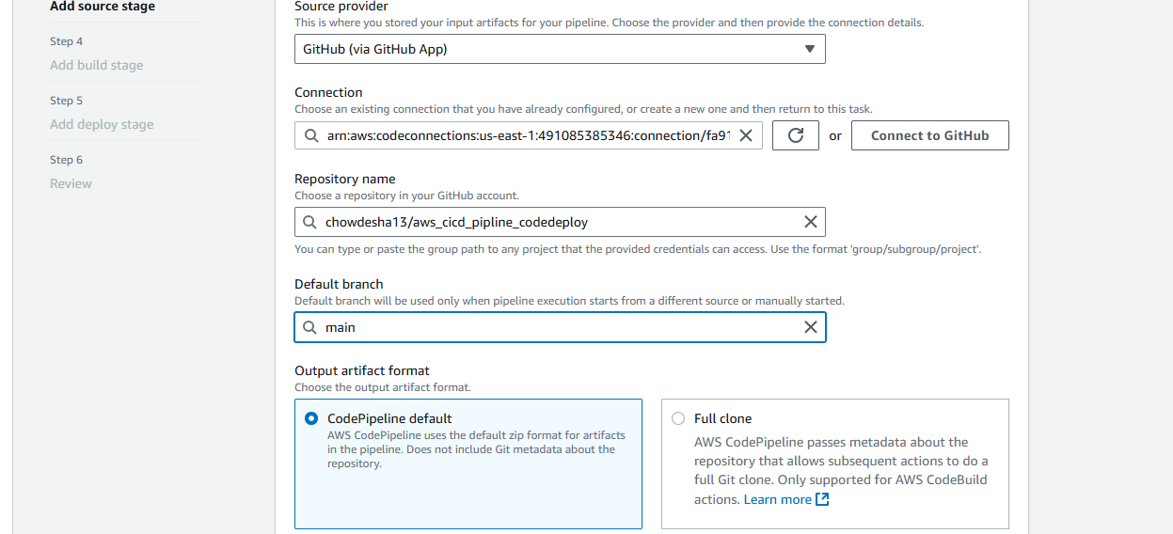
Connect to github using id and password and select given repository:

Slide 16
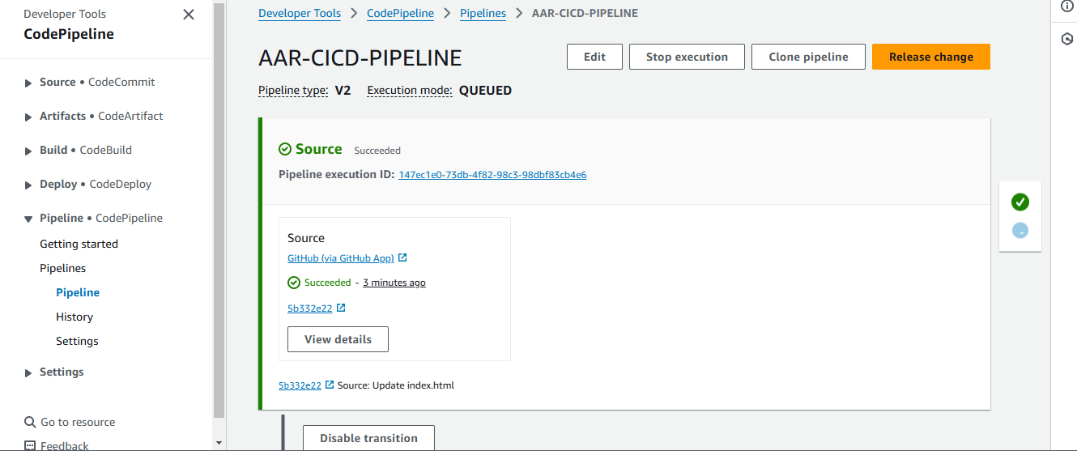
Codepipeline successfully created

Slide 17
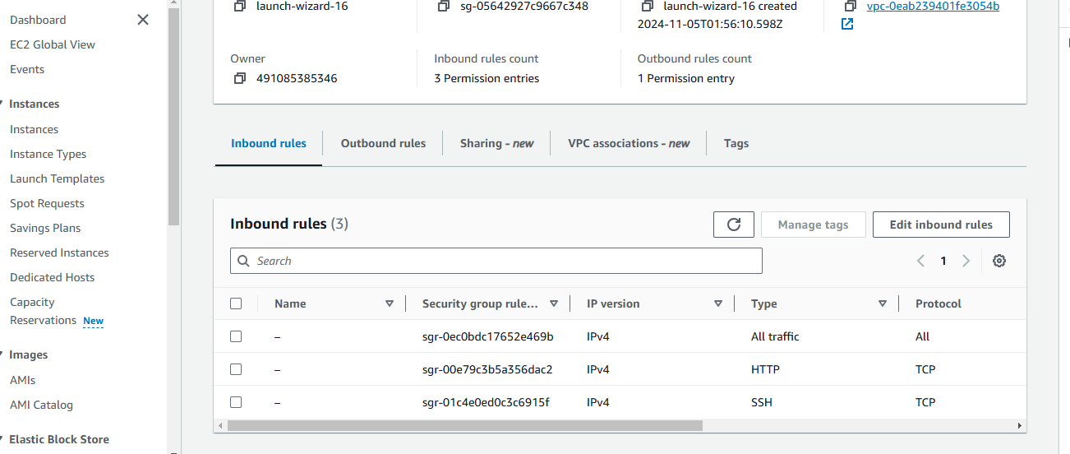
Add ssh http port in security groups

Slide 18
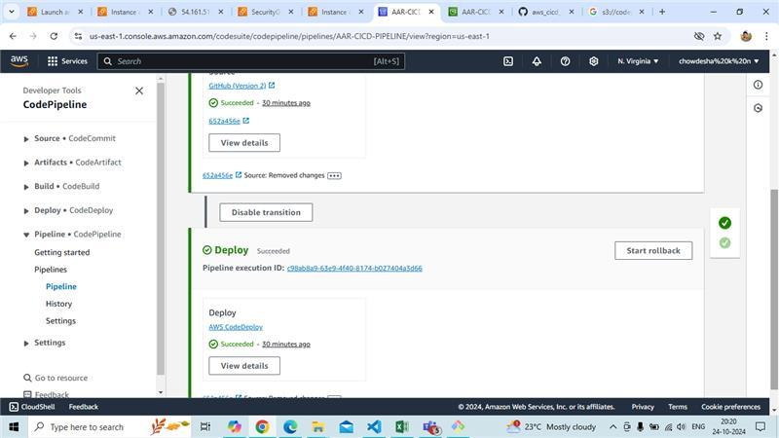
Code pipeline successfully created and code has successed.

Slide 19
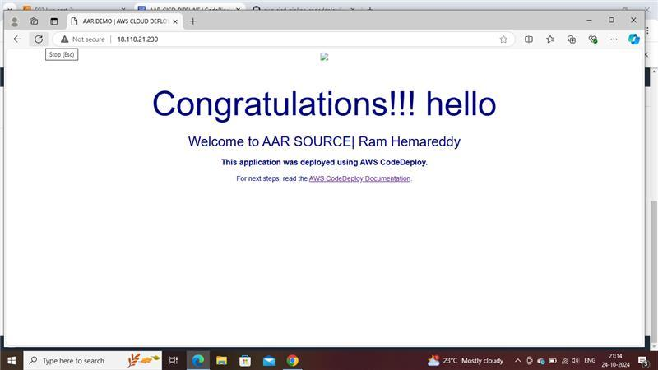
Copy IP address and paste in web browser and see the output

Slide 20
THANK YOU

